Slide 1

Module 8 B Statistical methods: Linear and Logistic Regression
PHW 2710 L
Epidemiology III
Miryoung Lee

Slide 2
Learning objectives
Review common statistical analysis methods used in cross-sectional and case-control studies
Simple and multiple linear regression
Simple and multiple logistic regression with binary outcome
Notes:
In this module, we will briefly review how to conduct linear and logistic regression analyses which are common analytical methods used in many cross-sectional and case-control studies.
Please refer to your biostatistics course materials more details on model assumptions and diagnostics.
General linear model or linear regression analysis is usually considered when the outcome variable (s) is a continuous variable such as participants’ height, or systolic blood pressure. The predictor variables or independent variables could be one or more and these can be continuous or categorical variables.
Logistic regression is the most popular choice of analytical methods when you have a categorical outcome. The categorical outcome may be binary (e.g., presence or absence of disease), multinomial (e.g., races/ethnicities) or ordinal (e.g., normal, mild and severe). The predictor variable(s) or independent variables may be continuous or categorical. For example, if consider to examine the presence or absence of coronary heart disease as outcome in relation to the exposure to smoking or air pollution as an independent variable, we can use binary logistic regression model. You can apply this method to more two categories. However, in this module we will focus on binary outcome.

Slide 3

Linear Regression
edX - Harvard University (Stata Learner) Week 10 – Linear regression
https://www.youtube.com/watch?v=0t9m6mLLps8&list=PL6p7gIm6aWd_08EeEhxLOUWnP-zu-04LA
1. Introduction - https://www.youtube.com/watch?v=0t9m6mLLps8
2. Simple linear regression - https://www.youtube.com/watch?v=XBx2bqC0V_0
(Tutorial) https://www.youtube.com/watch?v=i_ykF6Of8-U&list=PL6p7gIm6aWd_08EeEhxLOUWnP-zu-04LA&index=9
3. Multiple linear regression –
https://www.youtube.com/watch?v=s4O9bRm8D8o (Tutorial) https://www.youtube.com/watch?v=OorYxjfQdgc&list=PL6p7gIm6aWd_08EeEhxLOUWnP-zu-04LA&index=11
Notes:
Liner regression with continuous outcome is the most choice of analytical methods when you have continuous outcomes.
The number of outcome variables can be more than one, but we will focus on one outcome variable in this presentation.
Details on linear regression or regression analysis using either STATA or SAS is not the main part of this course.
However, you can refresh your memory by reviewing some edX presentations provided by Harvard University, School of Public Health.
Please check these edX Week 10: Linear Regression series if you would like to refresh your memory.

Slide 4
Part 1 - Linear regression

Slide 5
Describing the data using scatterplots
Form: Can the relation be described with a line (curved or random) ?
Direction: Do points tend upward or downward as X gets larger?
Strength of association: Do points adhere closely to a trend line?
Outliers: Are there any striking deviations from the overall pattern?
Notes:
In a next couple of slides, we will briefly review important concepts and statistical inference in linear regression modeling. Often in public health or epidemiologic research, the goal is to understand the relationship between two or more variables.
When you have data to examine the relationship of interest, plotting the relationship is often a good starting point. Scatterplots will depict the form of relationship, direction, and strength of relationships. It can also show that there may be some deviation.

Slide 6
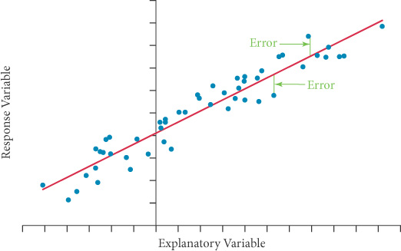
Random Variation
We would not expect data to line up perfectly.
Outcome variable
Dependent variable
Intercept
Predictor variable, independent variable
Notes:
We have a study goal that we want to understand the relationship between the response variable and explanatory variables. The response variable is also referred as outcome or dependent variable. The explanatory variable is referred as predictor, or independent variable.
Drawing a scatter plot or any plot will help us understand relationships in the data and we can relate a response (dependent, outcome, Y) to an explanatory (independent, factor, X) variable. When two variables appear to show a linear relationship, a line can be model to show how the outcome relates to the predictor variable like in this slide.
The line summarizes the relationship of the two variables. As you already knew, the data would not be expected to be fell perfectly on a line even though there is a very strong relationship.
The slop of the line represents what happens to the response when the explanatory variable changes (or increase) by one unit.
If two variables have a positive relationship, the slope is positive. If two variables have a negative relationship, the slope is negative.
If there is no relationship, then the slop is 0.

Slide 7

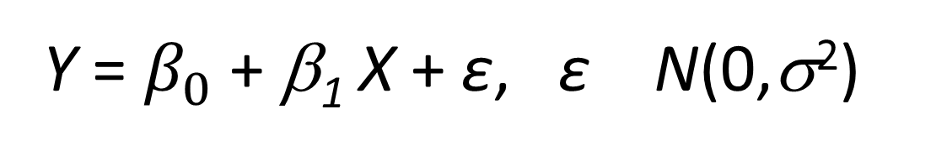
Statistical Models
You are already familiar with a statistical model that describes the linear relationship between X and Y.
Simple linear regression
Y = $β_{0}$ + β₁ X + ε, ε N(0,σ²)
A regressor or independent variable could be any relevant variable
that appears on the right hand side of the model equation or
that is associated with a slope in a linear regression model
Notes:
As you can see in the previous slide, the random variation can happen. The distance between the observed (blue dots) and predicted response (red line) is called as error or residual. Error happens because the explanatory variable or regressor can not explain all of the variation in the response. So for each observation, the distance between the line and actual points (blue dot) represent an error.
Based on the data, the true intercept and the true slope in the model can be estimated.
A regressor or independent variable could be any relevant variable that appears on the right hand side of the model equation or that is associated with a slope in a linear regression model.
Thus, given a response (or outcome) and an explanatory variable, the linear relation can be modeled as shown above.
Just a note that the intercept (beta 0) and the slope (beta 1) in a linear regression equation are parameters.

Slide 8
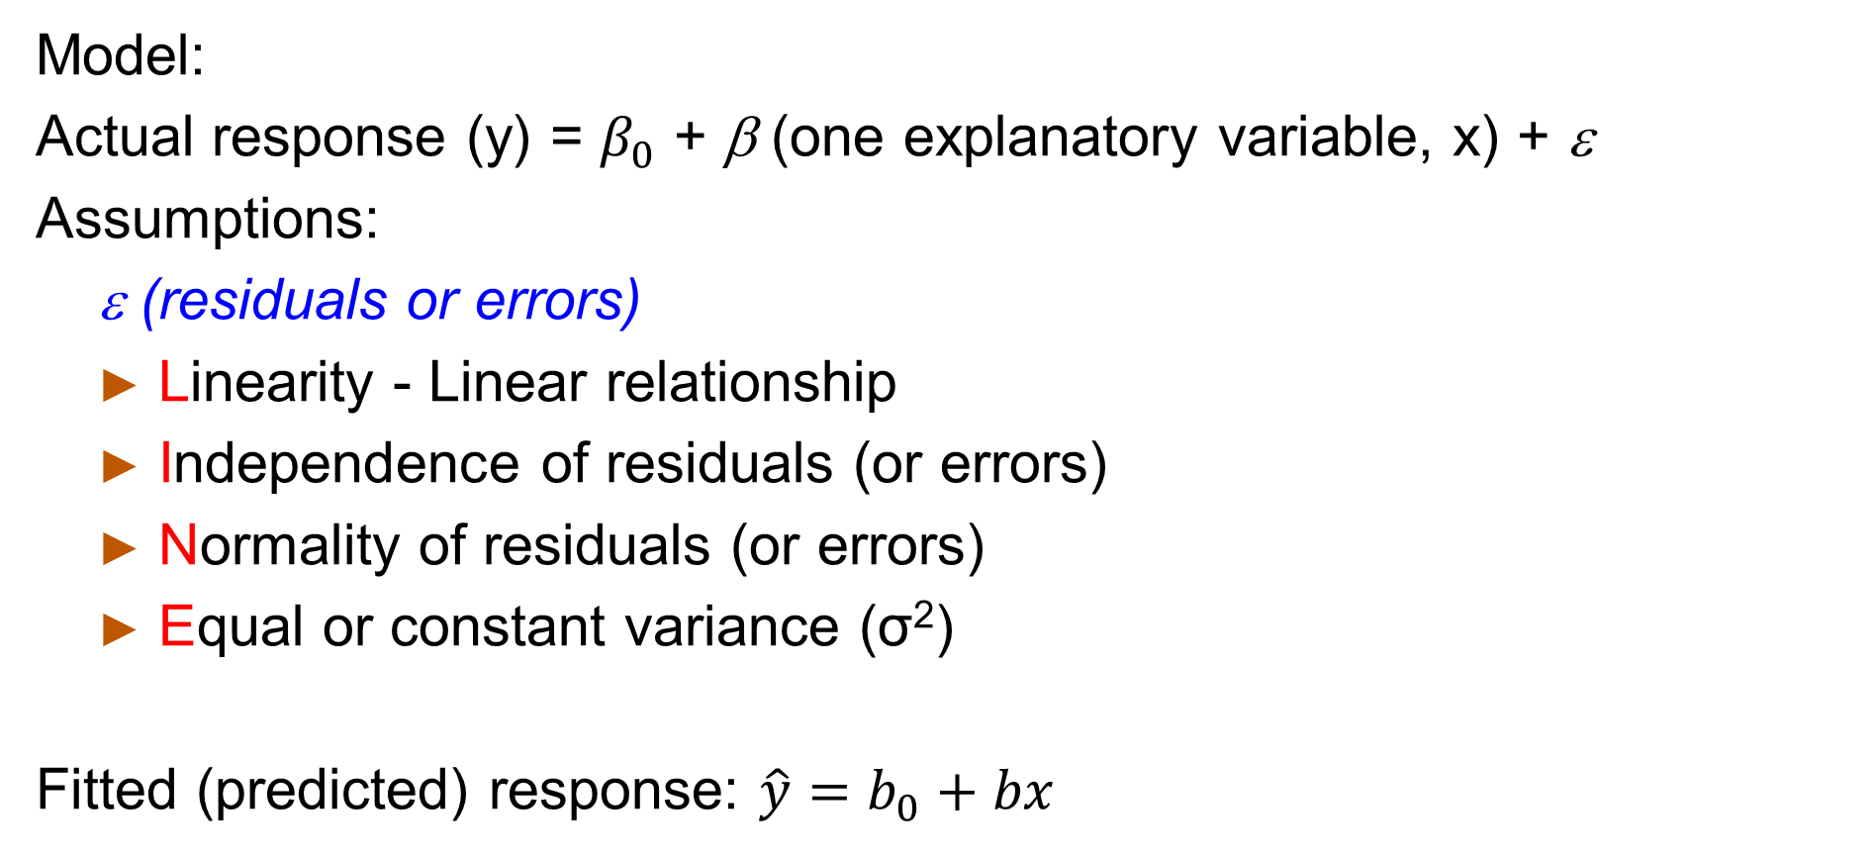
Simple Linear Regression (SLR) Model and assumptions
Model:
Actual response (y) = $β_{0}$ + β (one explanatory variable, x) + ε
Assumptions:
ε (residuals or errors)
Linearity - Linear relationship
Independence of residuals (or errors)
Normality of residuals (or errors)
Equal or constant variance (σ²)
Fitted (predicted) response: $\hat{y}=b_{0}+bx$
Notes:
The assumptions for this model include
Linearity
The subjects or experimental units are independent. In other words, errors or residuals should be independent.
The errors come from a normal distribution that has a mean of 0 and a constant variance.
Certain assumptions can be evaluated by analyzing the pattern of the residuals or errors (residual plot) using various model diagnostics.
Unlike the regression equation with error, the y with hat on is not the response observed in the data, but the response that would be predicted by the line. The distances between the observed response (y) and the predicted response (y hat) are the observed errors, e = y - $\hat{y}$. Please note that there is no error term in prediction equation (y hat = b0 + b1 times x) since this is not a model but a line.
The intercept (b 0) and the slope (b 1) in a linear regression equation are statistics (not parameters). Please check Module 5A slide #3 for the difference between statistics and parameters.

Slide 9
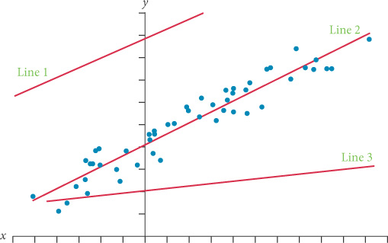

Least squares estimation
How do you choose the line?
Simple linear regression (SLR) describes the relationship in the data with a line that predicts the average change in Y for each unit increase in X.
Minimize the errors
– the smallest
squared distance (($y$ - $\hat{y})2)$.
Notes:
When we try to draw many lines to fit the data, we will need a strategy to find the best one.
The strategy is to minimize the errors (red double arrow in the plot). Some errors (e = y - $\hat{y}$) are positives while others are negatives. To prevent underestimating the errors, these errors are squared so that the squared differences are all positive.
The line is found using the least squared distance and the method for finding the line that best fits the data is called as ordinary least squares (OLS) regression as well.

Slide 10

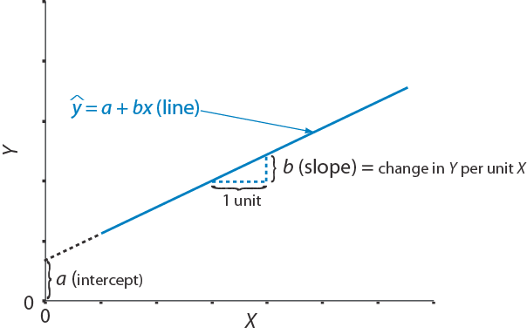
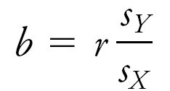


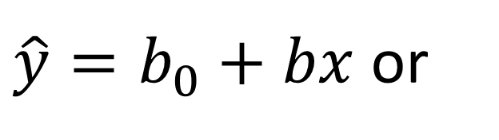
The prediction equation is:
where ŷ ≡ predicted value of y, a (or $b_{0}$) ≡ the y-intercept of the line,
And b₁ ≡ the slope of the line
Equations to calculate b₀ and b₁
SLOPE:
INTERCEPT:
$\hat{y}=b_{0}+bx$ or
Slope b is the key statistic
$$b_{0}= \overline{y} −b×\overline{x}$$
b₀
Notes:
So when we use statistical program to fit the data, intercept and slope are estimated based on least square estimation method or strategy.
The slope is calculated as estimate of the covariance of explanatory variable (x) and response variable (y) divided by variance of x.
The Intercept is calculated using sample mean of x (or x bar), sample mean of y (y bar) and the slope.
We will need to keep in mind a couple of notes when we interpret the regression results.
To place explanatory and response variable in appropriately
To check whether the model assumptions are met
To interpret the slope with appropriate units in x and y
To avoid extrapolation when we predict the response
To interpret the association appropriately (causation or not)

Slide 11
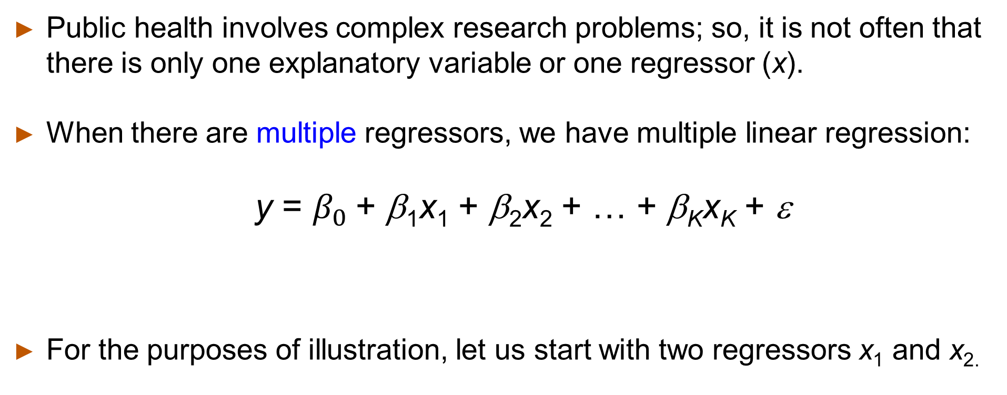
Multiple Linear Regression (MLR)
Public health involves complex research problems; so, it is not often that there is only one explanatory variable or one regressor (x).
When there are multiple regressors, we have multiple linear regression:
y = $β_{0}$+ β₁x₁ + β₂x₂ + … + β_{K}x_{K} + ε
For the purposes of illustration, let us start with two regressors x₁ and x_{2.}
# of regressors or independent variables: K
Notes:
Multiple linear regression is an extension of simple linear regression. It uses the same strategy to find the best fit for the data.
While a simple linear regression model (one explanatory variable) fits a line in two-dimensional space, a multiple linear regression (MLR) model with two explanatory variables fits a regression plane in three dimensional space.
A MLR model with k explanatory variables fits a regression “surface” in k + 1 dimensional space (cannot be visualized).
When we have k number of explanatory variables or regressors, we can linearly add each regressor in the model as shown above.

Slide 12
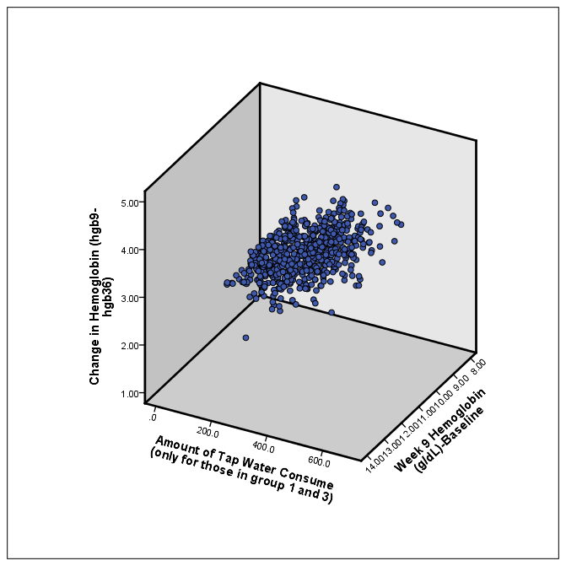
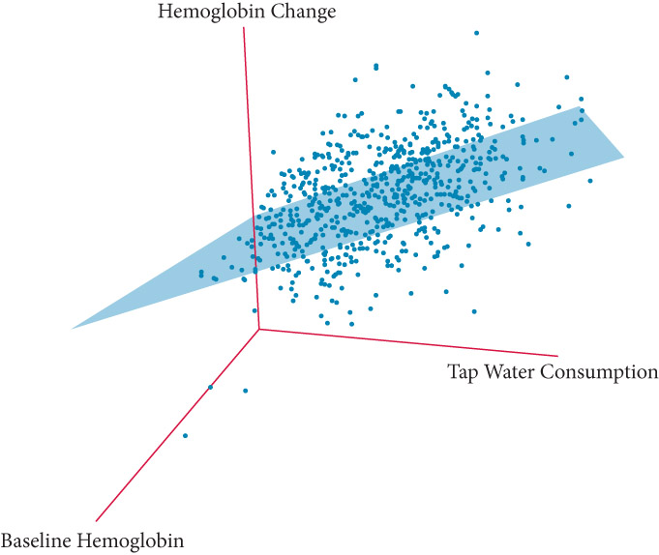
3-D scatterplot
Y or outcome
Two regressors
Notes:
Here is the 3D scatter plot to depict the regression model with two explanatory variables or two regressors. We will need to find a plane (flat surface) to best fit the data in hand.

Slide 13
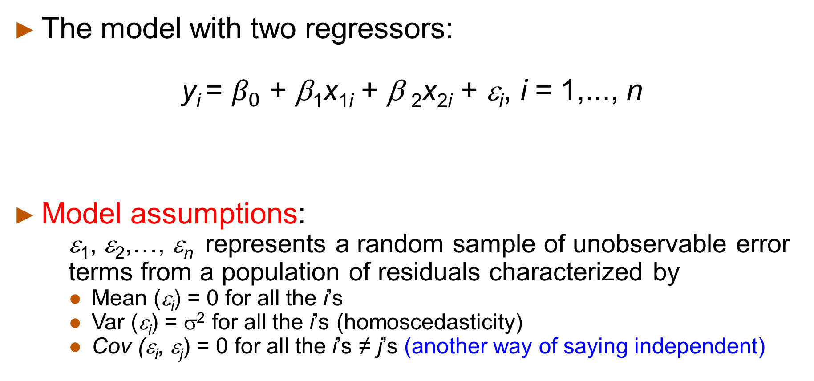
Statistical Model
The model with two regressors:
y_{i} = $β_{0}$ + β₁x_{1i} + β ₂x_{2i} + ε_{i}, i = 1,..., n
Model assumptions:
ε₁, ε₂,…, ε_{n} represents a random sample of unobservable error terms from a population of residuals characterized by
Mean (ε_{i}) = 0 for all the i’s
Var (ε_{i}) = σ² for all the i’s (homoscedasticity)
Cov (ε_{i}, ε_{j}) = 0 for all the i’s ≠ j’s (another way of saying independent)
Notes:
We have a linear regression equation for two regressors shown above. The model assumptions have not be changed much from a simple linear regression model.

Slide 14
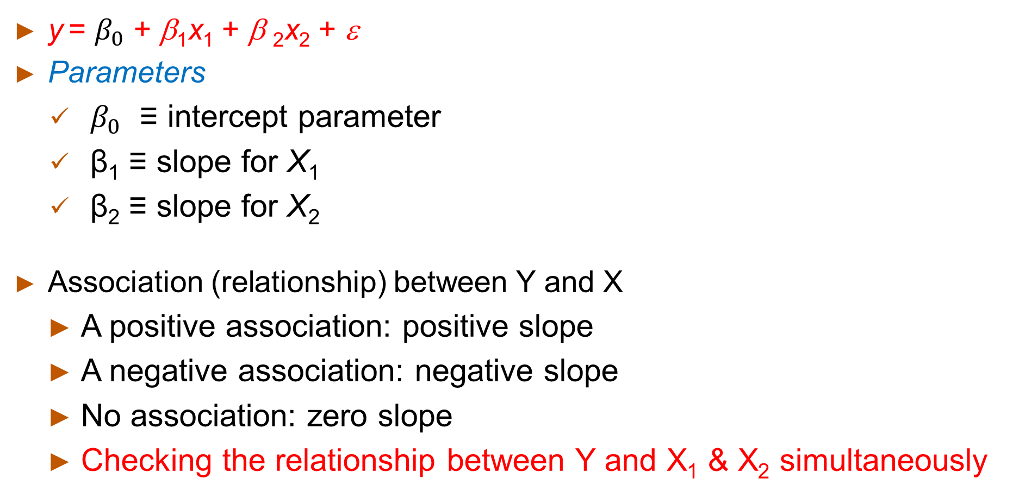
Two-Regressor Model
y = $β_{0}$ + β₁x₁ + β ₂x₂ + ε
Parameters
$β_{0}$ ≡ intercept parameter
β₁ ≡ slope for X₁
β₂ ≡ slope for X₂
Association (relationship) between Y and X
A positive association: positive slope
A negative association: negative slope
No association: zero slope
Checking the relationship between Y and X₁ & X₂ simultaneously
Notes:
In a model with two explanatory (independent or regressor) variables, we will have two slopes: one slope for 1st explanatory variable and the other for 2nd explanatory variable.
The relationship between Y and two Xs are estimated simultaneously.
As we interpreted in SLR, the positive slope between X1 and Y indicate the positive association or vice versa. The difference between simple linear regression and multiple or in this case, two regression models, we will need to consider the second regressor simultaneously included in the model.

Slide 15
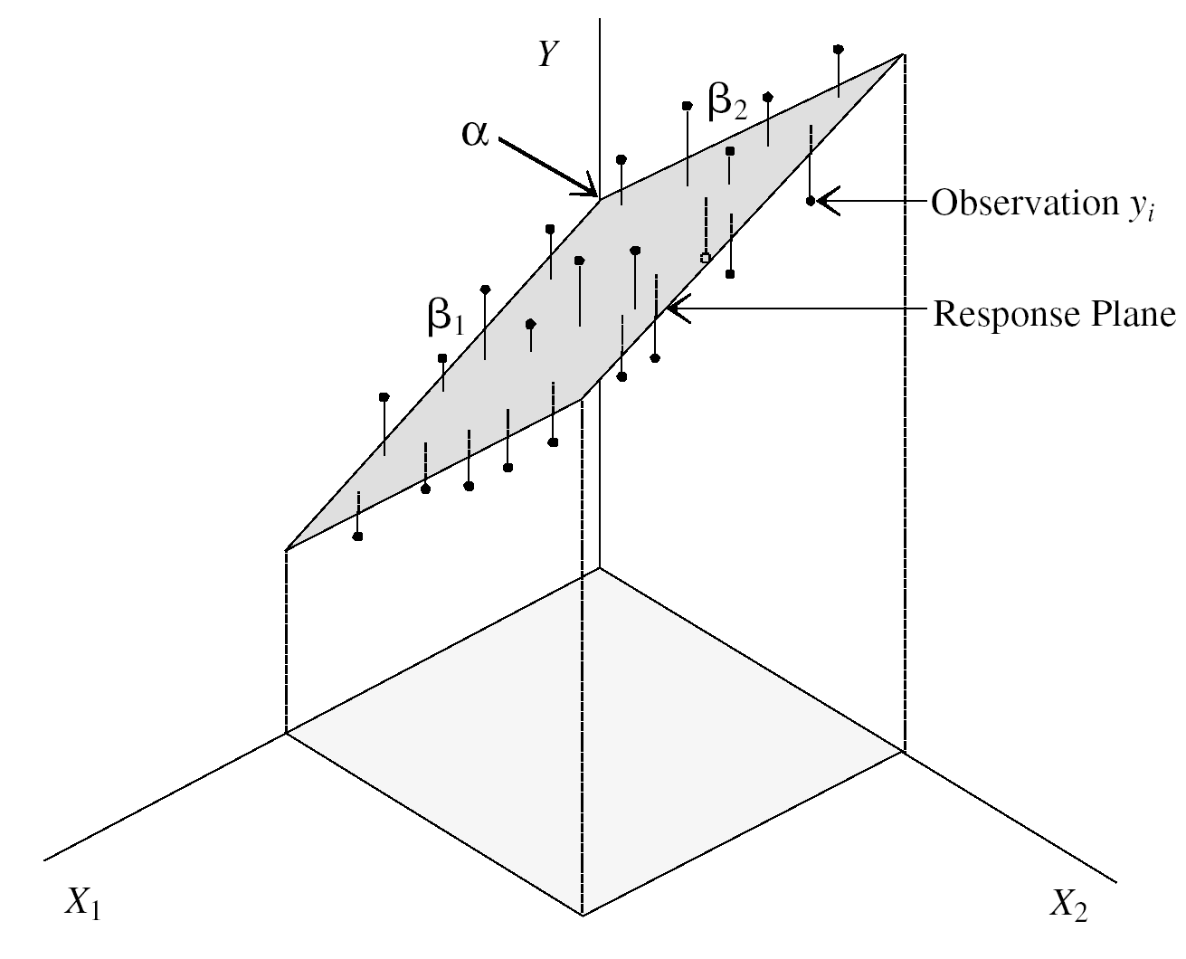
Interpretation of coefficients
The intercept predicts where the regression plane crosses the Y axis
The slope (b₁) for variable X₁ predicts the change in Y per unit increase in X₁ holding X₂ constant
The slope (b₂) for variable X₂ predicts the change in Y per unit increase in X₂ holding X₁ constant
Notes:
Each slope (b1 and b2) on this regression plane indicates the change in Y per unit increase in X1 or X2 while adjusting for each other in the model.
For example, a positive slope (b2) between X2 and Y in this example indicates the increase in Y per unit increase X2 while adjusting for X1 or while holding X1 constant.

Slide 16
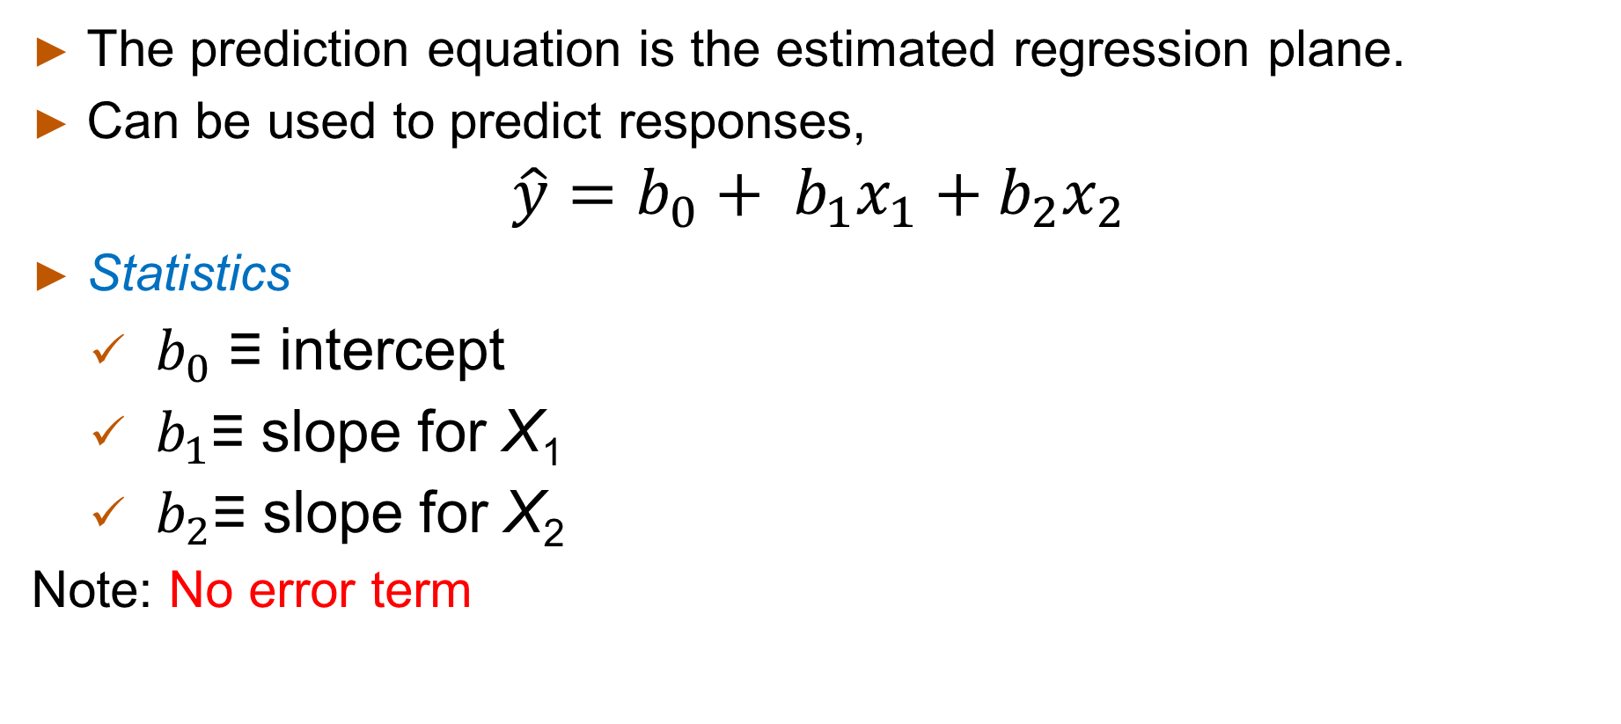
Regression plane
The prediction equation is the estimated regression plane.
Can be used to predict responses,
$$\hat{y}=b_{0}+ b_{1}x_{1}+b_{2}x_{2}$$
Statistics
$b_{0}$ ≡ intercept
$b_{1}$≡ slope for X₁
$b_{2}$≡ slope for X₂
Note: No error term
Notes:
Similar to simple linear regression, b0, b1, and b2 are point estimates or statistics describing the data or sample.
We will need to ask some questions based on these estimates.
Does a nonzero estimate of the slope 1 or b1 mean that the TRUE slope (beta 1) is not zero, or is the estimate specific to the SAMPLE?
Do we have evidence to claim that the true parameter or the true slop is not 0 or there is true linear relationship between Xs and Y?
Hypothesis testing in statistical inference can answer these questions.
Hypothesis tests can demonstrate whether the slope found in this sample is expected under the null hypothesis and confidence intervals for the slope provide a set of plausible values for the true slope.
Let’s estimate the slopes and confidence intervals and conduct hypothesis tests using an example dataset.

Slide 17
Depressive symptoms and sleep quality
Study question: Is the sleep disturbance or poor sleep quality associated with high depressive symptoms?
Outcome: Depressive symptom score measured using The Patient Health Questionnaire (PHQ-9) (Kroenke K, Spitzer RL, Williams JB, J Gen Intern Med. 2001;16:606-613, PMC1495268)
Exposure: Self reported sleep quality measured using Pittsburgh Sleep Quality Index (PSQI) questionnaire (Buysse DJ et al. Psychiatry Res 1989;28:193-213, PMID 2748771)
Confounders: age in years, body mass index (kg/m²), gender (women = 0 vs. men = 1), seasonality (other seasons = 0 vs. winter months = 1)
Notes:
I made a hypothetical dataset based on NHANES and other available data to examine a study question whether poor sleep quality is associated with higher depressive symptom score in a group of adults.
You can download PHQ9_sleep data file and data description file to work through this example on your own.
The outcome variable is called as PHQ9 score, which is a continuous variable that has a possible range of 0 to 27. This depressive symptom score is measured using the Patient Health Questionnaire or PHQ-9.
The exposure variable is called as PSQI, which is a composite score of sleep quality based on questionnaire, and it treated as a continuous variable that has a possible range of 0 to 21. This sleep quality index is measured using the Pittsburgh Sleep Quality index questionnaire. Since we are not sure of the temporality between sleep quality and depressive symptoms, we will treat poor sleep quality as an exposure variable and depressive symptom as an outcome variable in this analysis.
Let’s assume that following variables are known confounders in the relationship between sleep quality and depressive symptoms in other studies.
age, which is a continuous variable ranging between 30 to 80 years,
Body mass index, which is a continuous variable and is calculated as weight divided by height squared.
gender, which is a categorical nominal variable with two levels,
And seasonality, which is based on study visit month and a categorical nominal variable with two levels,

Slide 18
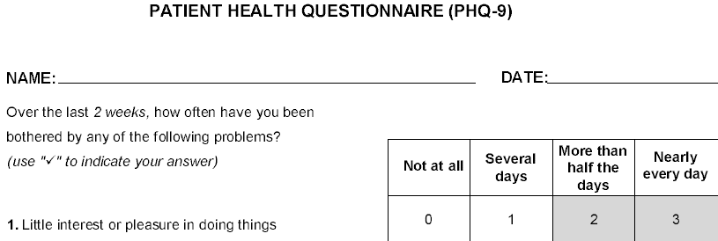
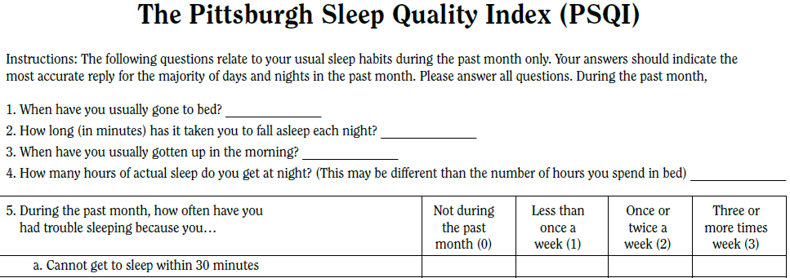
Notes:
This slide includes snapshots of PHQ-9 and PSQI questionnaires. More information on study questions can be found in original sources: 1) Kroenke K et al 2001 and 2) Buysse et al., 1989.
Higher score of PSQI represents the poor sleep quality and higher score of PHQ-9 represents more depressive symptoms.

Slide 19
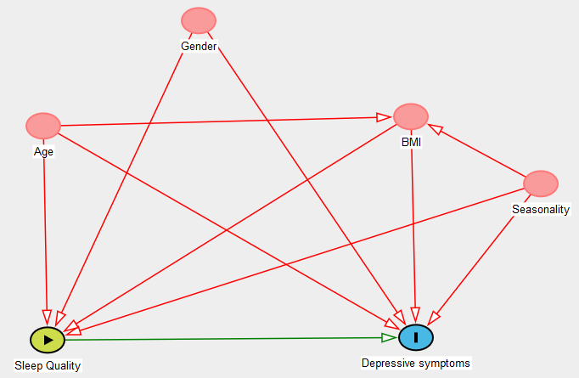
Statistical analysis plan
Potential DAG
Simple linear regression
To example sleep quality and
depressive symptom score
Multiple linear regression
To adjust for known confounders’ (age-50, BMI, gender and seasonality) effect on the relationship between sleep quality and depressive symptom
Note) We assume that all model assumptions for linear regression are met and other studies have suggested that all four covariates met the criteria for confounding.
Notes:
A potential DAG depicting the relationship between sleep quality and depressive symptoms with confounders is shown in this slide.
For the sake of simplicity, we will assume that all model assumptions for linear regression are met and other studies have suggested that these four variables met the criteria for confounding.
Also, we can center the age around 50 (or age - 50) considering sample mean age is about 50 and make the intercept in multiple linear regression to be more meaningful
Let’s start with a simple linear regression analysis. Then we will conduct a multiple linear regression that adjust for known confounders included in the dataset.

Slide 20
Descriptive characteristics
Notes:
Using STATA summarize function, we can generate descriptive statistics of variables in PHQ9_sleep dataset.
ID is random ID.
While the possible range of PHQ score is 0 to 27, actual range of PHQ9 in this dataset is 0 to 16 indicating that we do not have any participant reporting PHQ score more than 16.
Again PSQI ranges between 0 and 17 in this sample, while the possible range is 0 to 21. Overall, none of sample participant reported severe depression (PHQ9 >= 20).
Based on tabulated information, we know that 54.4% of sample are men and 68.6% of sample’s data were collected during the winder months.

Slide 21


Simple linear regression
regress phqscore psqi (Note: all STATA commands will be in blue font)
ANOVA table for overall model
Regression coefficient ($β_{PQQI}$)
Intercept
Test of Hypothesis: Null hypothesis $β_{PSQI}=0$
Notes:
Simple linear regression analysis results are shown in this slide.
Usually, the results consisted of two parts:1) analysis of variance or ANOVA table with model fit information and 2) least squares regression results with individual regression coefficient.
The first hypothesis test is to determine whether the (fitted) model explains does not explain enough variability in the response i.e., PHQ9 score (Null hypothesis).
F(1,202) statistic is calculated as ‘mean square model’ (999.19) divided by ‘mean square residual’ (4.52) on ANOVA table. According the test statistic, the variability in PSQ9 explained by the model is large enough to suggest that PSQI (sleep quality) and PHQ9 is linearly related.
In term of regression coefficient for PSQI score, we have 0.8288602 or 0.83. We can interpret this as one unit or one point increase in PSQI (poorer sleep quality) is associated with 0.83 point increase in PHQ-9 score.

Slide 22
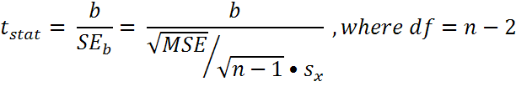
Test of hypothesis to test the slope (β coefficient)
Hypotheses. H₀: β_{PSQI} = 0 against H_{a}: β_{PSQI} ≠ 0
Test statistic.
P-value. Find P-value that corresponds t_{stat}
Notes:
Then what about the question: is PSQI (sleep quality index) associated with PHQ9 (depressive symptom score)? We can conduct specific hypothesis test for slop using T test statistic shown in the table.
T statistic is calculated b1 (or 0.8288602) divided by standard error of b1 (0.0557711). The degree of freedom (n-2=202) can be found on the ANOVA table or total n=204 minus 2.

Slide 23
TOH result for slope of PSQI (sleep quality)
Hypotheses. H₀: β_{PSQI} = 0 against H_{a}: β_{PSQI} ≠ 0
Test statistic: t_{stat} = 0.8288602/0.0557711 = 14.8618 ~ 14.86
P-value: |t| = 14.86 with df = 202 results in p-value of <0.0001(=T.DIST.2T(14.86, 202)).
Significance: At α = 0.05, p-value (<0.001) is less than alpha. So we do reject the null hypothesis.
Conclusion:
There is significant evidence that PQSI or sleep quality index is linearly associated with PHQ9 score.
In other words, one unit increase in PSQI (poorer sleep quality) is significantly associated with 0.83 point increase in PHQ-9 score.
Notes:
The null hypothesis of this hypothesis test is that the true slope (beta 1) is 0 or there is no linear relationship between the explanatory variable and response variable.
Based on the significance level (type 1 error) of 0.05 and T statistic, the p-value is small. So we can conclude that there is sufficient evidence to reject the null hypothesis (zero slope).

Slide 24
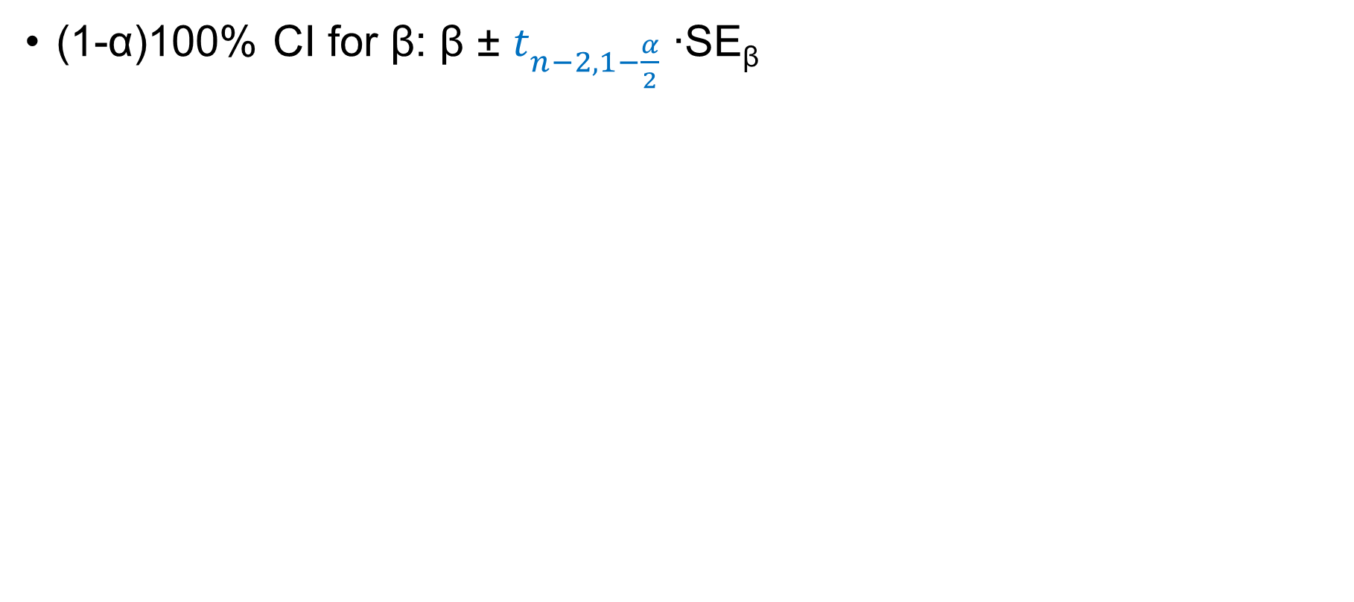
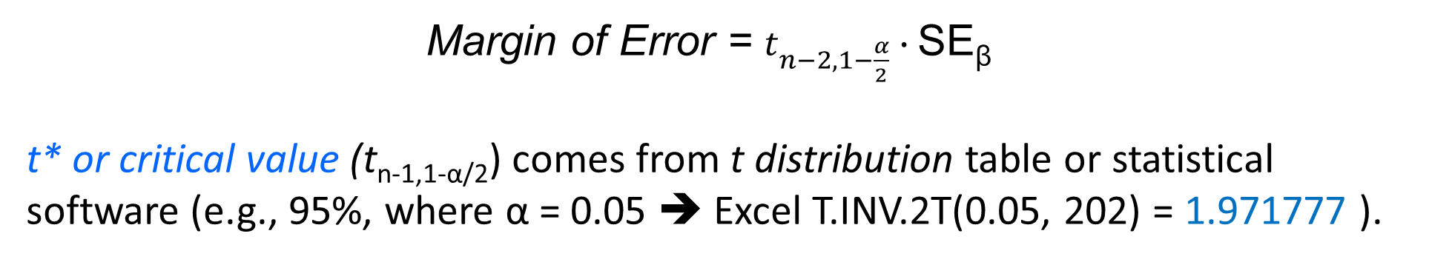
Confidence Interval for slope (β)
(1-α)100% CI for β: β ± $t_{n−2, 1−\frac{α}{2}}$ ∙SE_{β}
Margin of Error = $t_{n−2, 1−\frac{α}{2}}∙\text{SE}\text{β}$
t* or critical value (t_{n-1,1-α/2}) comes from t distribution table or statistical software (e.g., 95%, where α = 0.05 ➔ Excel T.INV.2T(0.05, 202) = 1.971777 ).
Notes:
The confidence intervals for true slope can be calculated using the information obtained from the output. In this example, 95% CI for slope beta lies between 0.7188921 and 0.9388284.
In other words, we are 95% confident that true parameter (or slope) will lie between 0.7188921 (or 0.72) and 0.9388284 (or 0.94).

Slide 25
Exercise
Conduct a multiple linear regression analysis that includes confounders (age, gender, BMI, seasonality) in the model.
Write a linear regression equation for the study question
Write the null hypothesis to test the relationship between the sleep quality and depressive symptom score.
Conduct the statistical analysis
Write the prediction equation based on the result
Notes:
Since you already open the STATA, please take a moment to answer the following questions or step.

Slide 26
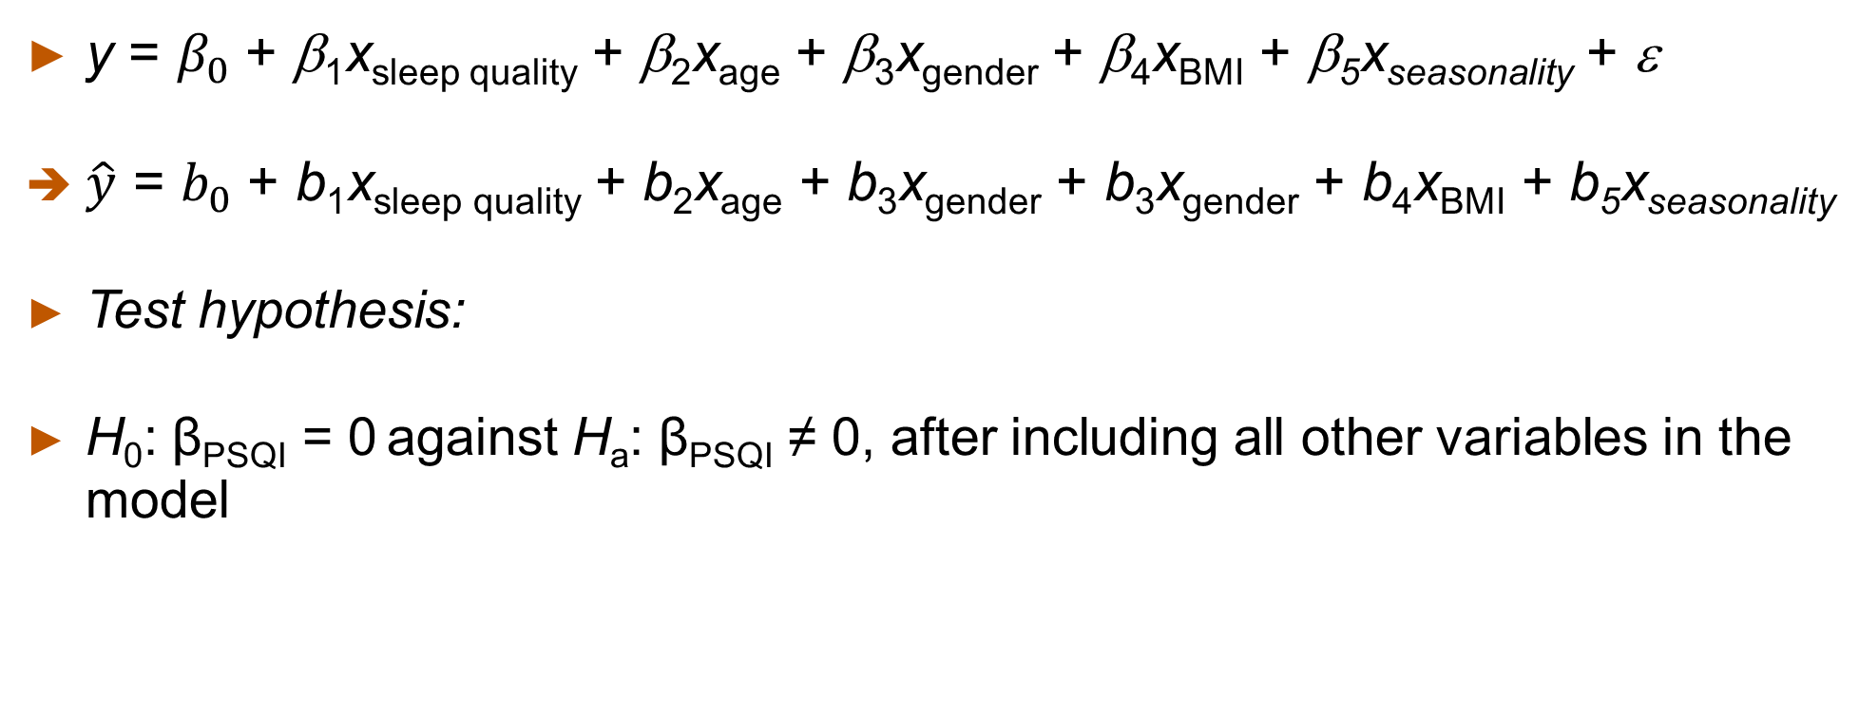
Exercise
y = $β_{0}$+ β₁x_{sleep quality} + β₂x_{age} + β₃x_{gender} + β₄x_{BMI} + β₅x_{seasonality} + ε
$\hat{y}$ = $b_{0}$+ b₁x_{sleep quality} + b₂x_{age} + b₃x_{gender} + b₃x_{gender} + b₄x_{BMI} + b₅x_{seasonality}
Test hypothesis:
H₀: β_{PSQI} = 0 against H_{a}: β_{PSQI} ≠ 0, after including all other variables in the model

Slide 27

Multiple linear regression analysis
regress phqscore psqi age50 i.gender bmi i.seasonality
Adjusted Regression coefficient ($β_{PQQI}$)
Test of Hypothesis: Null hypothesis $β_{PSQI}=0$
Notes:
This slide shows the multiple linear regression analysis results. In the model, main explanatory variable PSQI was included and other confounders are adjusted for as well.
Similar to the hypothesis tests for SLR, test of overall model using F-statistic and ANOVA table and test of hypothesis on specific slope, in this case slope for PSQI can be conducted.
The interpretation of slope is that the PHQ9 increases 0.8024536 (or 0.80) for every unit (1 point) increase in PSQI while adjusting for age-50, gender, BMI and seasonality. In other words, one unit increase in PSQI is associated with 0.80 increase in PHQ9 score while holding other confounders constant.
Regarding the test of hypothesis for slope for PSQI, we can conclude that there is enough evidence to reject the null hypothesis that the slope is 0 (no association) according to t statistic and its associated p-value.
Please try to interpret other slopes listed in the output.
With regards to the interpretation of categorical variables such as gender, the slope represent the adjusted mean difference in PHQ9 score between men and women (reference group).

Slide 28
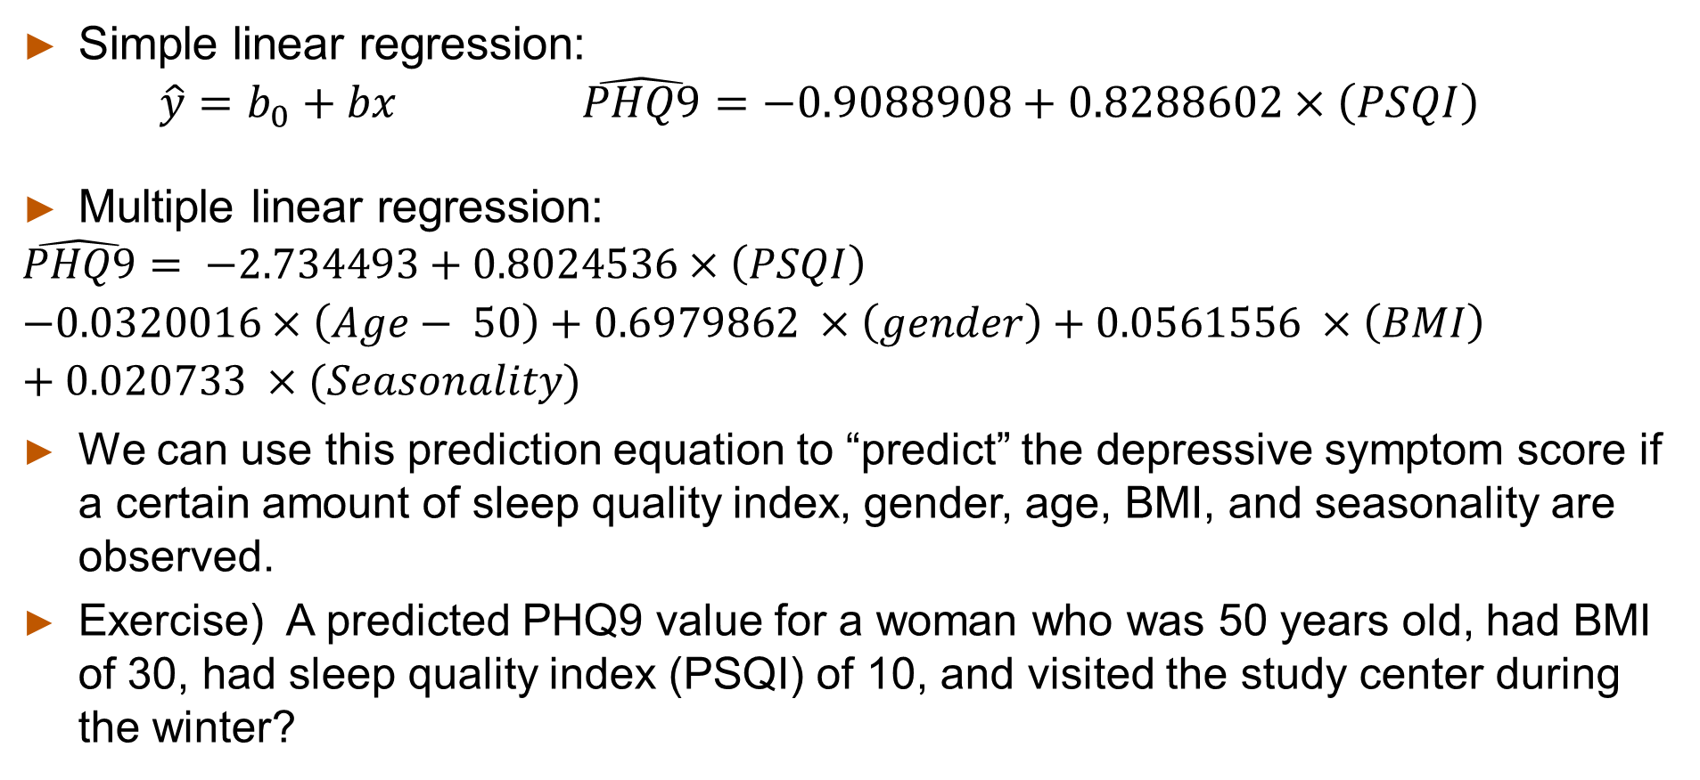
Prediction equation
Simple linear regression:
$$\hat{y}=b_{0}+bx \hat{PHQ9}=−0.9088908+0.8288602×\left(PSQI\right)$$
Multiple linear regression:
$$\hat{PHQ9}= −2.734493+0.8024536×\left(PSQI\right)$$
$$−0.0320016×\left(Age− 50\right)+0.6979862 ×\left(gender\right)+0.0561556 ×\left(BMI\right)+0.020733 ×(Seasonality)$$
We can use this prediction equation to “predict” the depressive symptom score if a certain amount of sleep quality index, gender, age, BMI, and seasonality are observed.
Exercise) A predicted PHQ9 value for a woman who was 50 years old, had BMI of 30, had sleep quality index (PSQI) of 10, and visited the study center during the winter?
Notes:
From the outputs shown in previous slides, we can construct the prediction equation as well.
While in epidemiologic and public health research, we may be less interested in using regression equations for prediction while we are more interested in examining the interpretation of beta estimates like we did in previous slides.
Nonetheless, we can calculate the predicted depressive symptom score based on these prediction equation.
For example, we want to predict PHQ9 value for a 50 year old woman with sleep quality index of 10 and BMI of 30. Also, her study visit occurred during the winter month (seasonality = 1).

Slide 29
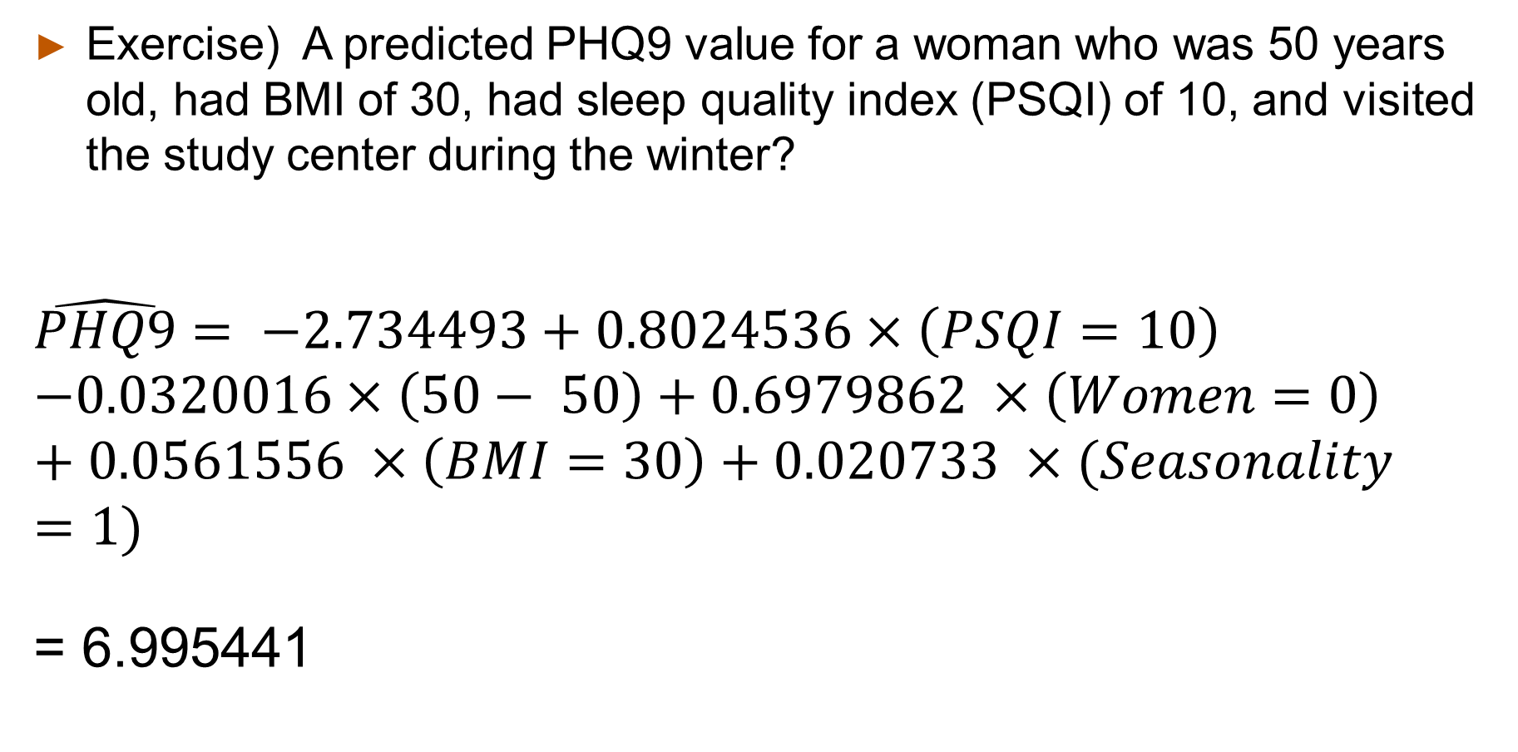
Exercise) A predicted PHQ9 value for a woman who was 50 years old, had BMI of 30, had sleep quality index (PSQI) of 10, and visited the study center during the winter?
$$\hat{PHQ9}= −2.734493+0.8024536×\left(PSQI=10\right)$$
$$−0.0320016×\left(50− 50\right)+0.6979862 ×\left(Women=0\right)+0.0561556 ×\left(BMI=30\right)+0.020733 ×(Seasonality=1)$$
= 6.995441
Notes:
According to calculation on the slide, the predicted value of PHQ9 should be 6.9954. One caution regarding the prediction is that we can not use any values outside the range of each variable included in the dataset. For example, we can not predict PHQ 9 value for any participant who are 18 years old or 72 years old. Similarly, we can not predict PHQ9 for a participant who had BMI of 60. Please check the descriptive characteristics of sample again.

Slide 30
Part 2 – Logistic regression
Notes:
Let’s switch the gears a little to review the statistical analysis that we can apply to a categorical outcome variable.

Slide 31

Logistic Regression
Frequently applied in case-control studies and cross-sectional studies with categorical outcomes
Primary analytical tool for multivariable analyses in (conventional) case-control studies
When the data come from a case-control study, the intercept is not readily interpretable, as the sampling fractions for cases and controls are arbitrarily selected by the investigator
In a case-cohort study or nested case-control study, the interpretation of regression coefficients can be used to estimate the risk as in the cohort study (i.e., the log of the odds ratio).
Notes:
Logistic regression is most frequently applied in case-control studies and cross-sectional studies with binary outcome. While you can use R by C contingency table that uses chi-square test statistic or Mantel-Haenszel test, logistic regression is very useful because many other variables in addition to an exposure variable can be included or adjusted for in one model. This method is one of most popular methods for epidemiologic data because of convenience and interpretability of its regression estimates or coefficients, which are easily translated into odds ratio estimates. In a case-control study, the interpretation of regression coefficients is similar to that of the cohort study: regression coefficient is the log of the odds ratio for change in that variable of interest. Furthermore, n a case-cohort study or nested case-control study, the interpretation of regression coefficients can be used to estimate the risk as in the cohort study (i.e., the log of the odds ratio). We will discuss these points in next two modules.

Slide 32

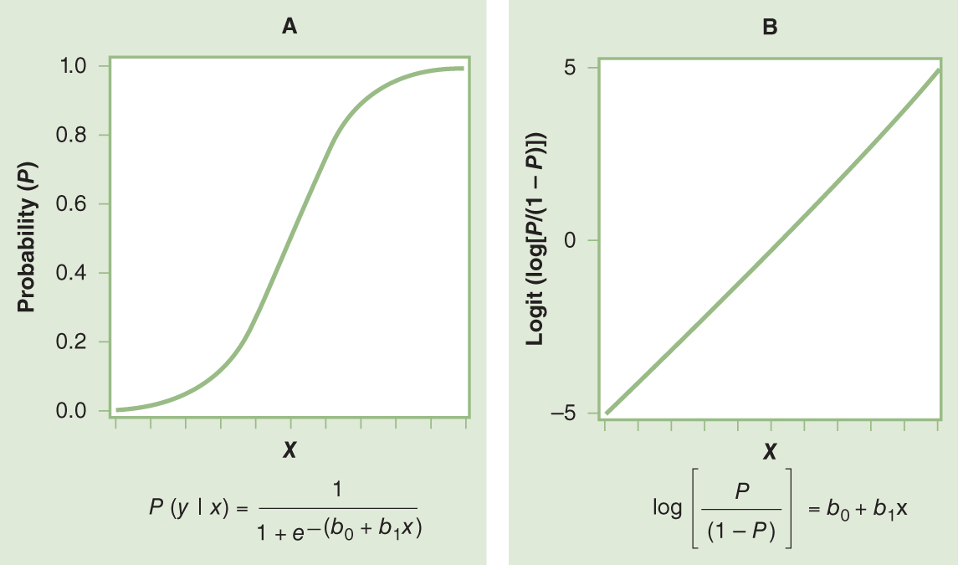

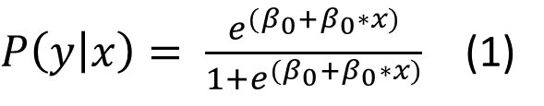
Odds of outcome
Odds = $\frac{P\left(event\right)}{P (no event)}$ = $\frac{P(Y=1|X=x)}{P(Y=0|X=x)}$ = $\frac{P(Y=1|X=x)}{1−P(Y=1|X=x)}$= $\frac{P(y|x)}{1−P(y|x)}$
Log (odds) or logit of P(y|x) ➔
$P\left(y | x\right)= \frac{e^{(β_{0}+β_{0}∗x)}}{1+e^{(β_{0}+β_{0}∗x)}}$ (1)
(2)
Notes:
Let’s review some basics that you already know. One of major assumptions in linear regression is the normality distributed error terms. The residuals or errors are not normally distributed or constant when we regress binary outcome on predictors.
So the binomial distribution is used to describe the distribution of errors or residuals in the logistic model.
Logistic regression is a type of generalized linear model, which is an extension of linear model. In a simple linear regression model, the relationship between an independent variable and a dependent variable is said to be linear. Probability of event (yes vs no) in relation to X is depicted in figure A here. Logistic (or logit) function is the equation (1) in the slide, and it models the conditional probability of the response. It can transformed into equation (2).
Odds is the ratio of two probabilities; probability of event happening and probability of event not happening. Thus log of odds is the log of p over (1-p), which can be reduced in to a linear regression equation, intercept (beta zero) plus a regression coefficient, beta 1 times independent variable.
Advantages of logit function include that it allows to have values between –infinity and +infinity and it is directly related to odds of disease or event.

Slide 33
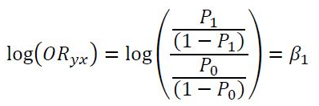
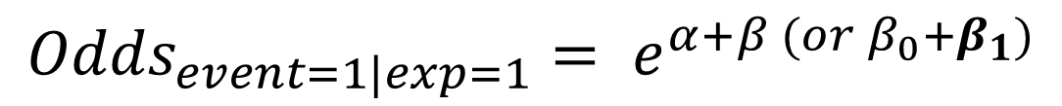
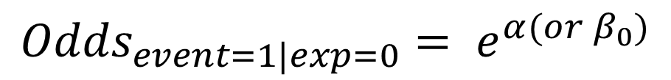
How to interpret the slope (β) of exposure (X) from logistic regression output
$${Odds}_{event=1|exp=1}= e^{α+β (or β_{0}+β_{1})}$$
$${Odds}_{event=1|exp=0}= e^{α(or β_{0})}$$
Notes:
If we think the situation in 2 by 2 table format, the odds of disease given exposure (x=1) and the odds of disease among the unexposed (x=0) are indicated in the slide.
The odds ratio for the odds of disease among the exposed as compared to the odds of disease among the non-exposed (Disease OR) simplifies to exponential function ($e^{beta 1})$.
For one unit change in given variable (x), which may mean the difference between exposed and unexposed or 1 unit change in continuous variable such as age, beta coefficient means the increase in logarithm of the OR.

Slide 34
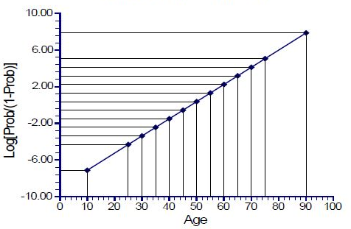
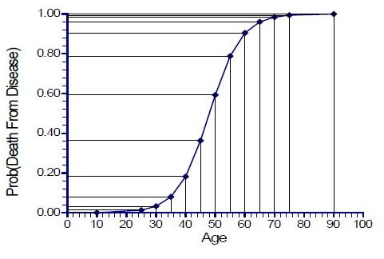

Binary logistic regression analysis with continuous variable
{
$$β_{0}+ β_{1}X$$
logit of P(y|x) = log(Odds)
Image source: PASS 2015 Chap 860. Logistic regression
Notes:
Independent variables (i.e., called as Xs, or predictor variables) can be categorical variables or continuous variables. These two figures illustrate the binary outcome (diseased or non-diseased) in relation to age (years) in a continuous scale.

Slide 35
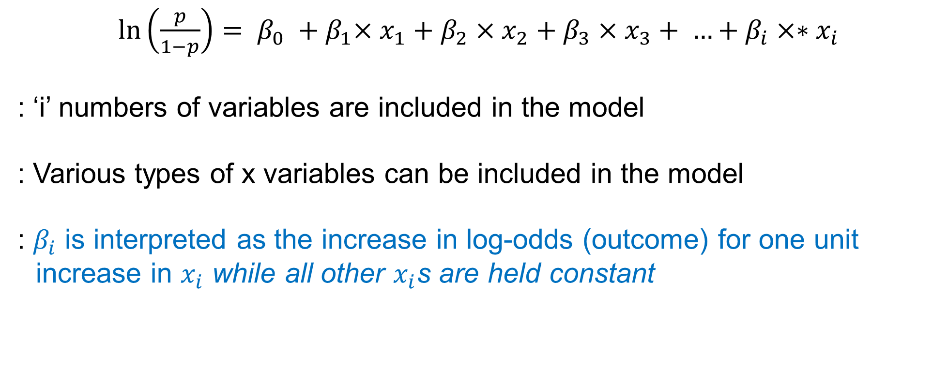
Multiple logistic regression
$\ln\left(\frac{p}{1−p}\right)= β_{0} {+ β}_{1}×x_{1}+β_{2}×x_{2}+β_{3}×{x_{3}+ …+β}_{i}×∗x_{i}$
: ‘i’ numbers of variables are included in the model
: Various types of x variables can be included in the model
: $β_{i}$ is interpreted as the increase in log-odds (outcome) for one unit increase in $x_{i}$ while all other $x_{i}$s are held constant
Notes:
A simple logistic regression model can be extended to a multiple logistic regression model that include as many as independent variables. $β_{i}$ is interpreted as the increase in log-odds (outcome) for a one unit increase in $x_{i}$ while all other $x_{i}$s are held constant or adjusted for all other $x_{i}$.

Slide 36
Example: Low birth weight infant
Study question: Is the maternal smoking during the pregnancy related to having low birth weight (LBW) babes?
Code sheet: Lowbwt_description.txt
Outcome – LBW babies
Case definition: mothers with LBW babies (birthweight ≤ 2500 g)
Control definition: mothers with non LBW babies (> 2500 g)
Exposure definition: smoking (yes) during pregnancy
Other covariates: age of mothers (years), maternal race/ethnicity (1 = white, 2=black and 3 =others) etc.
Hosmer and Lemeshow, Applied Logistic Regression 2nd Ed, Ch 2
Notes:
Let’s look at another example. I download a sample dataset that include an outcome variable called “low”, which describes the outcome status: case moms with low birth weight babies and control moms without low birth weight babies.
Just note that the dataset does not reflect the ideal case-control study scenario.
Consider you or other investigators were interested in examining whether maternal smoking is related to the risk to having low birth weight infants.
In this hypothetical study, your team designed a hospital based case-control study and recruited mothers. Or think of a hospital based cross-sectional study that include moms who just gave a singleton birth.
Pretend that you have collected exposure information and other variables information from 59 case mothers (mothers with low-birth weight babies) and 130 control mothers.
The source of dataset is Hosmer and Lemeshow book, Applied Logistic Regression 2nd Edition. You can download the uploaded lowbwt.dta or tab delimited text file from Canvas. Please check the code sheet (lowbwt_description.txt file).
More detailed information can be found on following website: https://stats.idre.ucla.edu/stata/examples/alr2/applied-logistic-regression-second-edition-by-hosmer-and-lemeshowchapter-2-multiple-logistic-regression/

Slide 37
2 x 2 table approach
cc low smoke (all STATA commands will be in blue fonts)
The null hypothesis (H₀) : OR = 1
Notes:
Let’s look at the study question without considering any confounders.
The OR is 2.022 and 95%CI is 1.039 and 3.966. If we interpret 2.022 as EOR, we can say that the odds of smoking during the pregnancy among mothers with LBW babies are 2.022 times the odds of smoking among mothers without LBW babies (controls). EOR, greater than 1, indicates that the odds of exposure among case mothers are greater than the odds of exposure among controls. We are 95% confident that the true EOR falls between 1.029 and 3.966. Considering that 95%CI does not include ‘1’, we can safely say that the OR of 2.022 is significantly different from 1 without formal test of hypothesis (Null hypothesis; OR=1). The null hypothesis is that OR is equal to 1 or in other words, there is no association between maternal smoking during the pregnancy and LBW.
When you use the equation fro 95%CI information that you’ve been using, you will have a slightly different 95%CI estimate: 1.081, 3.783.
Based on information of chi-square test statistic (4.92), and 1 degree of freedom, we obtain the p-value of 0.0265 from chi-square distribution and we do reject the null hypothesis at the significance level of 0.05.

Slide 38
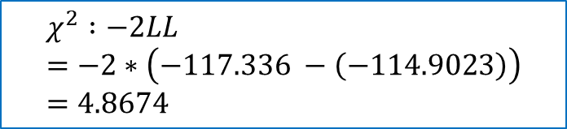
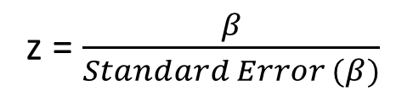
Interpretation of logistic regression coefficient
logit low smoke
logit low smoke, or (to request OR)
$$χ^{2} :−2LL=−2∗\left(−117.336 −\left(−114.9023\right)\right)=4.8674$$
z = $\frac{β}{Standard Error (β)}$
Notes:
Let’s use a simple logistic regression analysis. The beta coefficient for smoke is 0.7040592 and 95%CI for beta coefficient does not contain ‘0’ suggesting that the beta coefficient is significantly different from 0.
The test statistic for beta coefficient is based on z-statistic from normal distribution and is calculated as beta coefficient dividing by standard error of beta.
Please note that in some statistical software program (e.g., SAS), Wald chi-square statistic is calculated instead of z statistic.
Wald chi-square is just a squared value of ‘z’ statistic and it is based on chi-square distribution.
According to p-value of 0.028, we do reject the null hypothesis of beta = 0 and conclude that there is evidence of significant relationship between smoking and having LBW babies.
As you can, the results (chi-square statistic) are slightly different because logistic regression model (in general ) uses maximum likelihood estimation method.
Log likelihood from the model without smoke (called null model) and log likelihood from the model with smoke (called full model here considering that there is only one independent variable) is compared and multiplied by 2. This -2LL is an approximate chi-square statistic with 1 df. This value is shown as LR chi2(1)
The log-likelihood ratio test statistic is = - 2 (-117.336 – (-114.9023)) = 4.8674. The p-value is obtained from a chi-squire distribution with 1 degree of freedom ( 2 – 1 = 1 df).
Log likelihood without smoke = - 117.336 (null model, 1 df for intercept)
Log likelihood with smoke = - 114.9023 (full model, 2 dfs for intercept and smoke variables)
L

Slide 39

Equation: $\ln\left(\frac{p}{1−p}\right)=−1.0871+0.7041×Smoking$
EOR = exp(0.7040592) = 2.022
95%CI = exp (0.0775716, 1.330547) = (1.081, 3.783)
Notes:
As you can see OR is calculated as exponentiation of beta coefficient. As you see on the output, you can ask OR rather than beta coefficients.

Slide 40
Multiple logistic regression
Confounding factor?: maternal weight at last menstrual period
Methods to adjust for confounding during data analysis?
Stratification → Mantel-Haenszel OR
Multiple logistic regression → included LWT as a covariate
LWT: Body weight of mom
Smoking
LBW babies
Notes:
Let’s pretend that weight of mother at last menstrual period (LWT) is a potential confounding factor in the relationship between maternal smoking and having LBW babies. If we are using “STRATIFICATION” method to adjust for a confounding factor, ‘LWT’, which is a continuous variable, we will need to group moms into certain strata based on arbitrary cut-off points. You can use mean weight value of 129.8148 pounds to group moms into two strata and then your can calculate Mantel-Haenszel (MH) odds ratio (or adjusted OR) from two strata. If you can not remember how to calculate MH Odds ratio, please check our textbook (S & N), page 273-278.
If you are using multiple logistic regression, you will not need to make stratified samples because the regression method will accept continuous variables as well as categorical independent variables. Let’s take this approach now.

Slide 41
logit low smoke lwt
logit low smoke lwt, or
Interpretation of adjusted OR
Notes:
Here are the STATA outputs that include beta coefficient and OR for smoke. The null hypothesis is that the slope (beta) for smoking is 0, after controlling for LWT in the model. In other words, the OR for smoking is 1, after controlling for LWT in the model.
Based on statistical test results at significance level of 0.05, we do reject the null hypothesis and conclude that the slope or beta for smoking is significantly different from 0 after controlling for LWT in the model.
The interpretation of adjusted OR in this case will be:
the odds of smoking during the pregnancy among mothers with LBW babies are 1.967 times the odds of smoking among mothers without LBW babies (controls) after controlling for LWT (or while LWT is held constant in the model).
At the end, if you compare adjusted versus unadjusted beta coefficients for smoking, the difference due to adjustment for LWT was less than 10%.
Please try to use the dataset to familiarize the logistic regression analysis. You can incorporate other covariates such as age of mother, or race/ethnicity information which may be another confounder that needs to be considered.

Slide 42
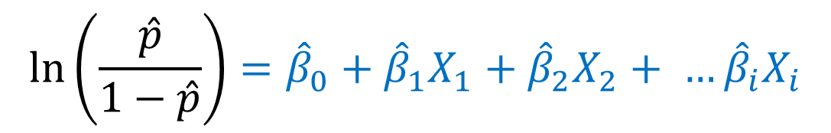
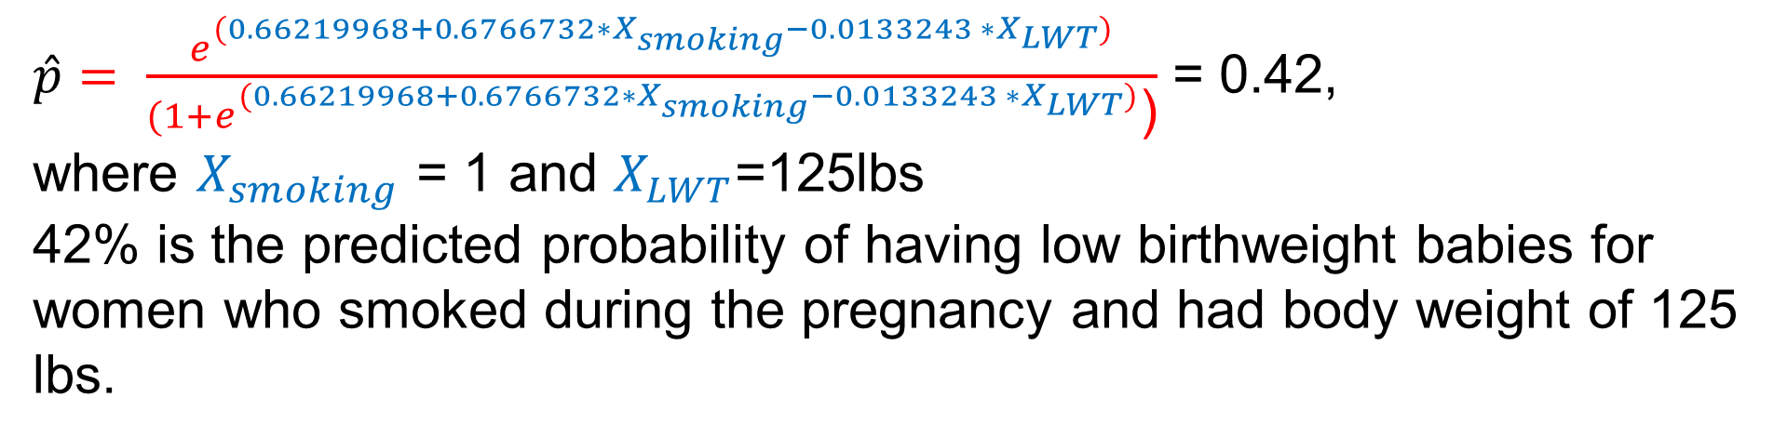
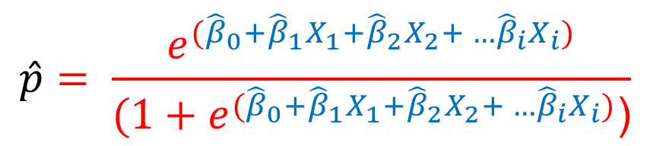
Probability of outcomes: Prediction Equation
Beta coefficient or Odds Ratio?
$$\ln\left(\frac{\hat{p}}{1−\hat{p}}\right)={\hat{β}}_{0}+{\hat{β}}_{1}X_{1}+{\hat{β}}_{2}X_{2}+ …{\hat{β}}_{i}X_{i}$$
$$\hat{p}= \frac{e^{({\hat{β}}_{0}+{\hat{β}}_{1}X_{1}+{\hat{β}}_{2}X_{2}+ …{\hat{β}}_{i}X_{i})}}{(1+e^{({\hat{β}}_{0}+{\hat{β}}_{1}X_{1}+{\hat{β}}_{2}X_{2}+ …{\hat{β}}_{i}X_{i})}\text{)}}$$
$\hat{p}= \frac{e^{(0.66219968+0.6766732∗X_{smoking}−0.0133243 ∗X_{LWT})}}{(1+e^{(0.66219968+0.6766732∗X_{smoking}−0.0133243 ∗X_{LWT})}\text{)}}$ = 0.42,
where $X_{smoking}$ = 1 and $X_{LWT}$=125lbs
42% is the predicted probability of having low birthweight babies for women who smoked during the pregnancy and had body weight of 125 lbs.
Notes:
The beta coefficients (or estimates) can provide a prediction equation. The prediction equation for a logistic regression has the form shown in the slides. Some investigators may be interested in trying to predict the probability of outcome (or LBW) using exposure and covariates in the model.
So for our example, we can construct the predicted probability of an outcome as shown above. P hat should be between 0 and 1.
To calculate the predicted probability of having LBW for mom who smoked during the pregnancy ($X_{smoking}$ = 1) and weight at last menstrual period was about 125 lbs ($X_{LWT}$= 125)is about 0.42 or 42%.
Just remember that the estimation of probabilities or prediction equation is only as good as the data used to create or predict it! In order to avoid unreasonable predictions, independent variables in the model should be carefully included .

Slide 43
Caution on the use of logistic regression with cohort or cross-sectional data
The adjusted odds ratio is often used as a surrogate of the relative risk.
Justified only for the analyses of rare outcomes
When the frequency of the outcome of interest is high, the odds ratio is a biased estimate of the relative risk (or the prevalence rate ratio)
Notes:
As you already know that the adjusted odds ratio is often used as a surrogate of the relative risk or prevalence rate ratio from the logistic regression analysis. If the rarity assumption is not met, the OR would a biased estimate of risk ratio.

Slide 44

Linear regression – STATA and SAS
STATA
Simple and multiple linear regression https://stats.idre.ucla.edu/stata/webbooks/reg/chapter1/regressionwith-statachapter-1-simple-and-multiple-regression/
SAS
https://stats.idre.ucla.edu/sas/webbooks/reg/chapter1/regressionwith-saschapter-1-simple-and-multiple-regression/
Notes:
Let’s conclude this module by adding more information from UCLA Institute for Digital Research and Education. This website had been a wonderful source for quick references for me while it is a little outdated now. Here are some web links for you to look at if you want to use STATA and SAS to conduct analyses in addition to refresh your memory. Again, more sophisticated program codes are beyond the scope of this class.

Slide 45

Acknowledgements
This presentation includes some material/examples/slides from:
Szklo & Nieto, Epidemiology: Beyond the Basics 4th Edition
Hosmer & Lemeshow, Applied Logistic Regression analysis, 2nd edition
Bush, Heather M. Biostatistics: an applied introduction for the public health practitioner. 1st edition. Delmar Cenage learning, Clifton Park, NY
edX - Harvard University (Stata Learner)
https://stats.idre.ucla.edu/
Notes:
As usual, we will end this lecture with acknowledgments for the sources that helped in making this lecture.

